Slide 1
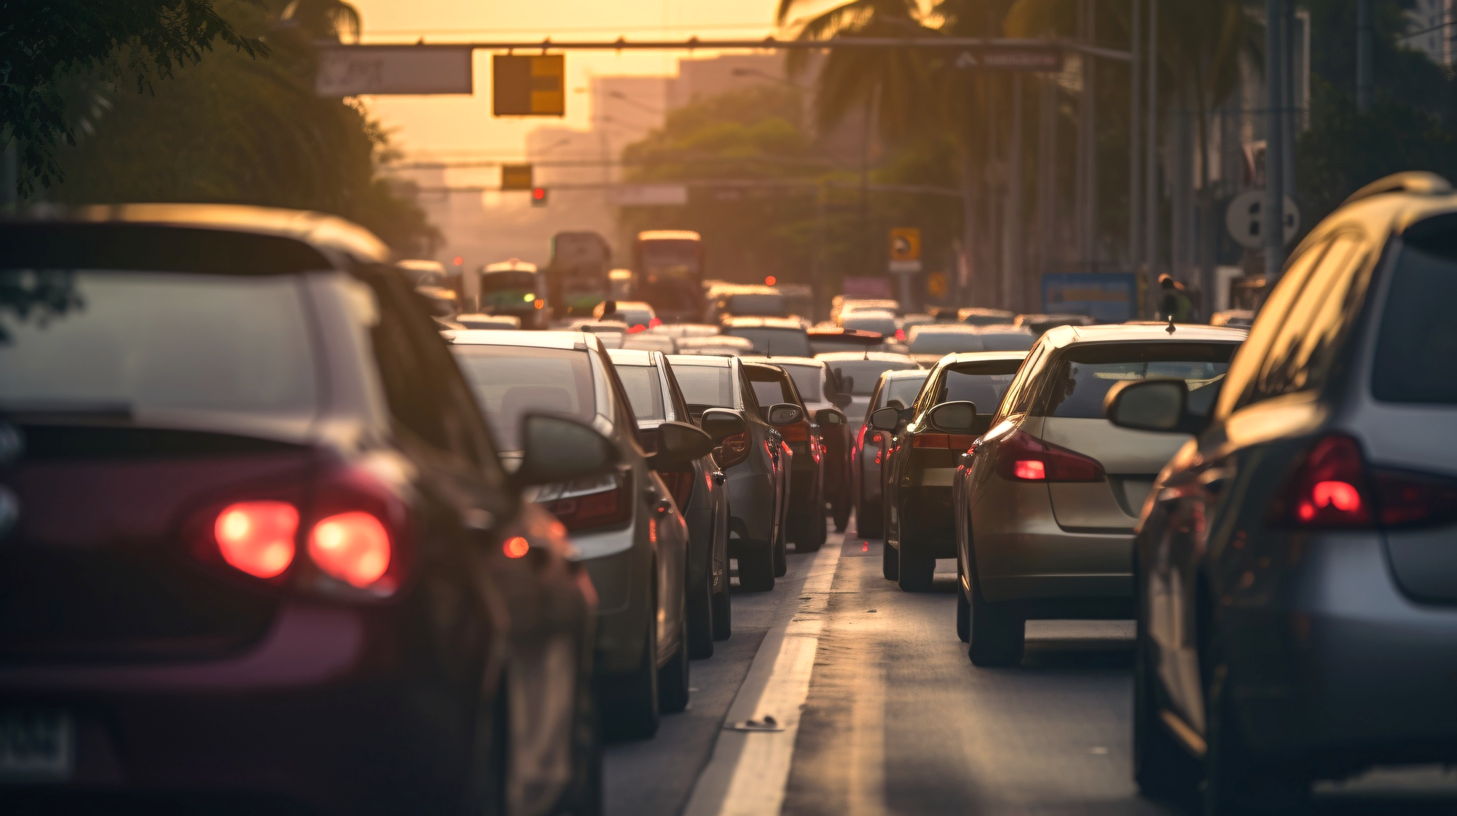
New York City Traffic Collisions
Presented by: Pruthvirajsinh Solanki

Slide 2
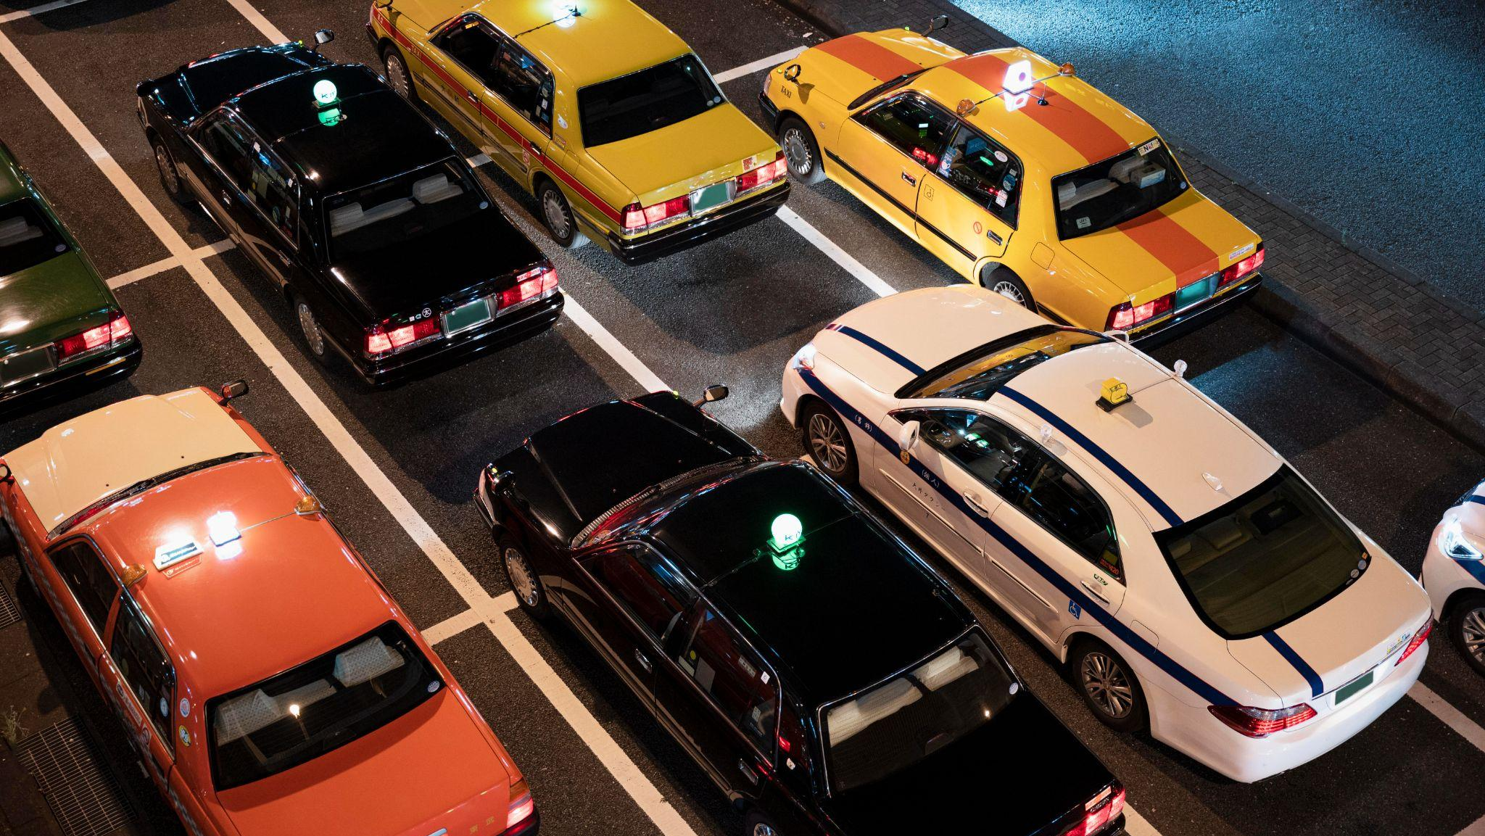
Problem Statement
Motor vehicle collisions reported by the New York City Police Department from January 2021 to April 2023. Each record represents an individual collision, including the date, time, and location of the accident (borough, zip code, street name, latitude/longitude), vehicles and victims involved, and contributing factors.

Slide 3
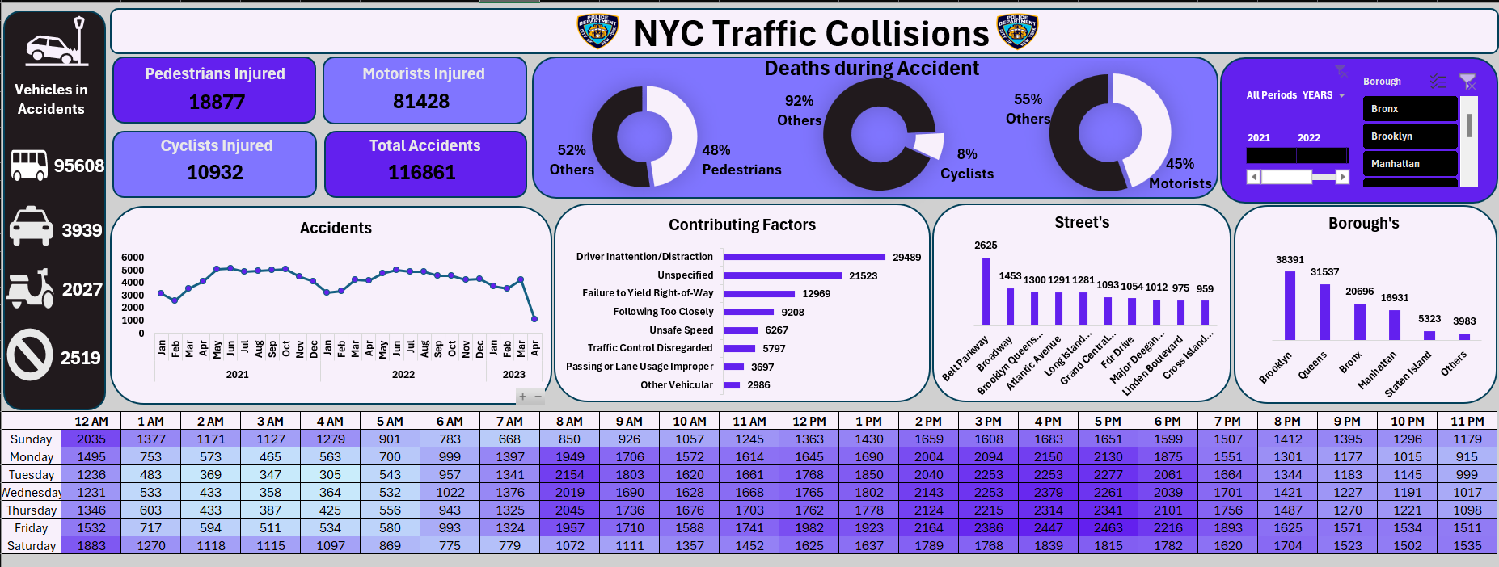

Slide 4
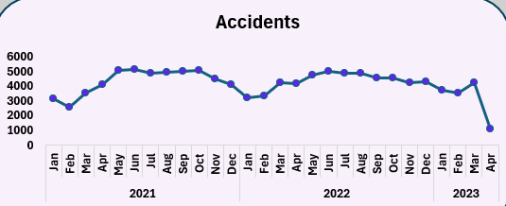
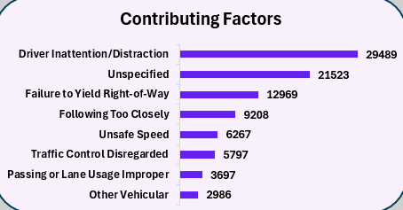
Insights
The line chart shows us that the number of accident during period of 2021&2022 were stable around 5k which got reduced in 2023 first quarter
The main contributing factor for causing accidents in NYC is the Distraction or Driver Inattention while driving that is around 29k in numbers

Slide 5
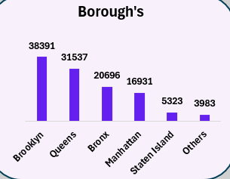
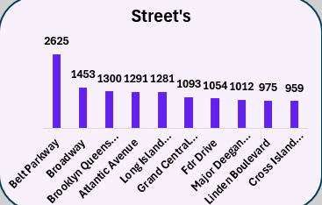
Insights
Brooklyn and Queens are the Borough’s with most number of accidents reported with around 38k.
Considerind Brooklyn as the main location with highest number of accident, It has Belt Parkway Street as the highest contributor in terms of accident with 2.5k accidents combined.

Slide 6

Insights
The highest number of accidents occur on Fridays, followed by Thursdays and Wednesdays.
Peak accident hours are typically between 3 PM and 6 PM.
There were 116,861 total accidents recorded.

Slide 7
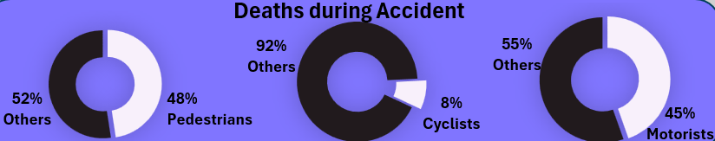
Insights
Pedestrians account for 48% of deaths, despite being involved in fewer accidents overall.
Cyclists represent 8% of fatalities, which is disproportionately high given their lower involvement rate.
Motorists, despite being the most numerous group in accidents, account for 45% of fatalities.

Slide 8
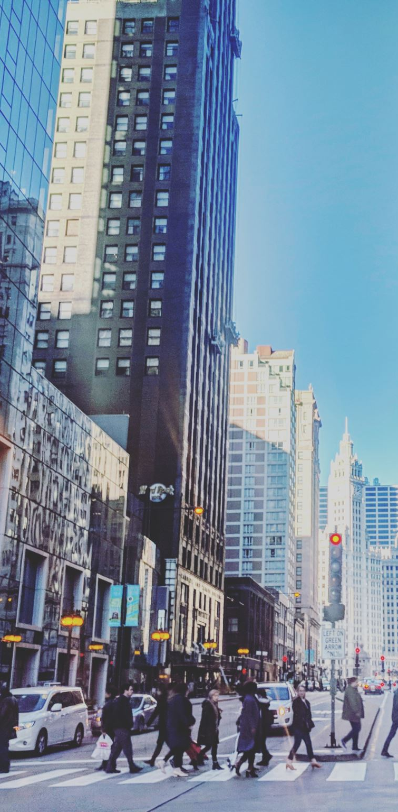
Recommendations
Implement more pedestrian-friendly infrastructure like protected crosswalks and longer crossing times, especially in high-risk areas.
Expand dedicated bike lane networks, particularly in Brooklyn and Queens where accident rates are highest.
Increase traffic enforcement during peak accident hours (3 PM to 6 PM) and on high-risk days (especially Fridays).
Develop tailored safety plans for Brooklyn and Queens, given their higher accident rates. Analyze what makes Manhattan relatively safer despite its density, and apply lessons to other boroughs.

Slide 9
Thank You

